Slide 1
Maternal Health Risk in Rural Bangladesh
Mani Katuri, Sean Paz, Chris Alleyne, & Nabeel Khan
Notes:
Chris

Slide 2
Background
In areas where access to health facilities is lacking, maternal health risks are among the most common. Complications with fetal development are more likely to happen in pregnant women residing in remote, resource-limited areas.
Prenatal care, medical facilities, and access to trained health professionals are grossly inadequate. Early risk detection can help avoid complications and ensure mother-child health.
Early identification of high-risk pregnancies will help in implementing better management and intervention strategies for the reduction of adverse outcomes. Decision support systems aided by machine learning models can play an important role in assisting health workers who need to assess risk levels and prioritize care accordingly.
Notes:
Chris: “Let’s get into it. As Sean mentioned, we’re looking into ways to combat maternal health risk in rural areas by ways of predictive modeling. In the developed world, pregnancy is far-less of a life-risk these days, because of our access to gold standard care. Not all people are dealt the same hand. Pregnant women in remote areas have limited access to basic resources, let alone life-saving care for a major complication during pregnancy. This is where we aim to help. Early detection and early identification are key metrics for survival in these scenarios. Our decision support system, aided by machine learning, can help combat this issue.

Slide 3
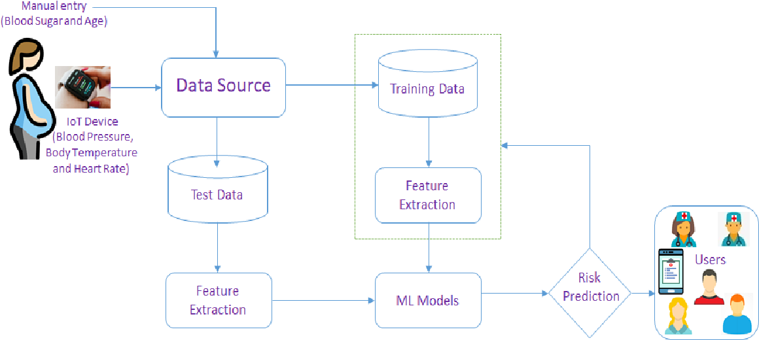
Objective
The prime objective of this study is to come up with a decision tree model that can predict, with key health metrics, risk levels in maternal health. This model can work as a decision support system for healthcare providers in the remote areas of Bangladesh to make prudent decisions regarding treatment.
Notes:
Chris: Infant mortality has been a major concern in many underdeveloped or developing countries even to this era. Many pregnant women and children lose their lives with severe health conditions, and this is due to lack of proper medical monitoring systems and information about maternal health care. “Seems almost rudimentary, but we established a machine learning algorithm that can take simple classifiers and predict risk severity with fairly reasonable accuracy.”

Slide 4
Methods
Data Cleaning and Preparation: The data is collected only in correlation to bodily conditions of the patients. No external factors are taken into consideration at the time of data collection.
The data is examined using python code and with several cross tabs built to observe if there are any conclusive causing factors for the maternal risks. The record set is clean enough with no null values and the values are all valid for the features selected.
Notes:
Sean

Slide 5
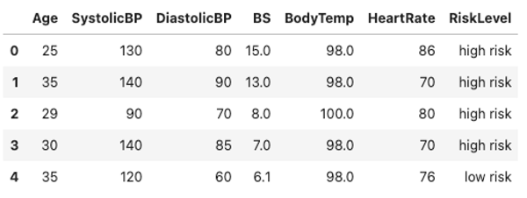
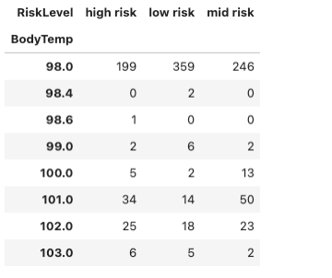
Data Statistics
Notes:
Sean

Slide 6
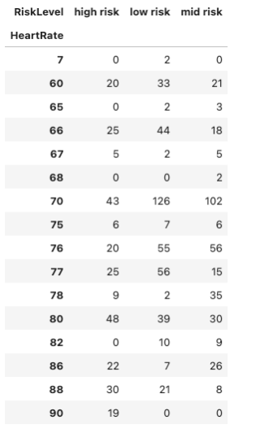
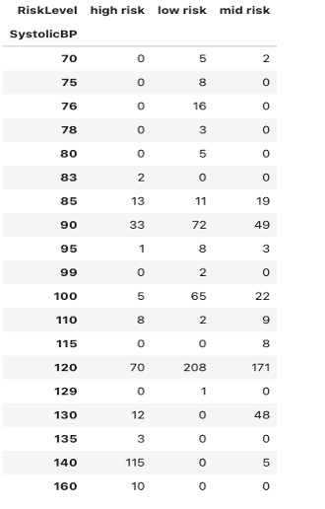
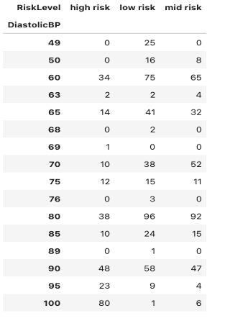
Data Statistics
Notes:
Sean

Slide 7
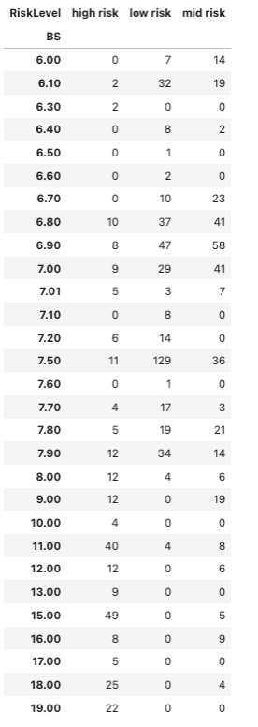
Data Statistics
Notes:
Sean

Slide 8
Methods
Data Processing: The data is categorized as two equal halves of test and training data. Groups of data is fit into SVM, Decision tree, GridSearchCV, RandomizedSearchCV through python code.
The GridSearchCV algorithms have a hyperparameter tuning capability to get the best parameters.
Notes:
Sean

Slide 9
Model Algorithm
BEGIN
Read the input file and loop through each patient record
LOOP
Choose features from the patient record
Calculate significance for each feature, calculate accuracy and error rate
Implement statistical data approach and calculate the best value for a combinationß
For other combination of features repeat the loop
END LOOP
COMPARE with trained data and test data
Predict the output risk level and display the valuesß
END
Notes:
Mani: . GridSearchCV prediction accuracy scores against training and test datasets.

Slide 10
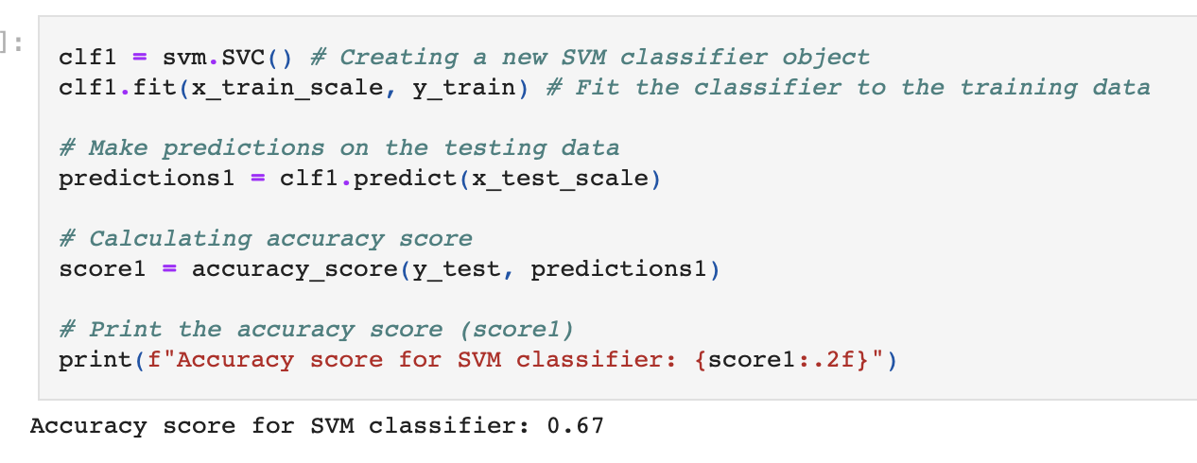
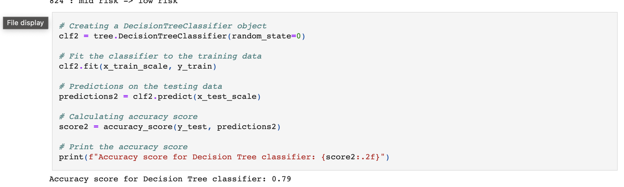
Accuracy Scores (Decision Tree and SVM)
Notes:
Mani

Slide 11
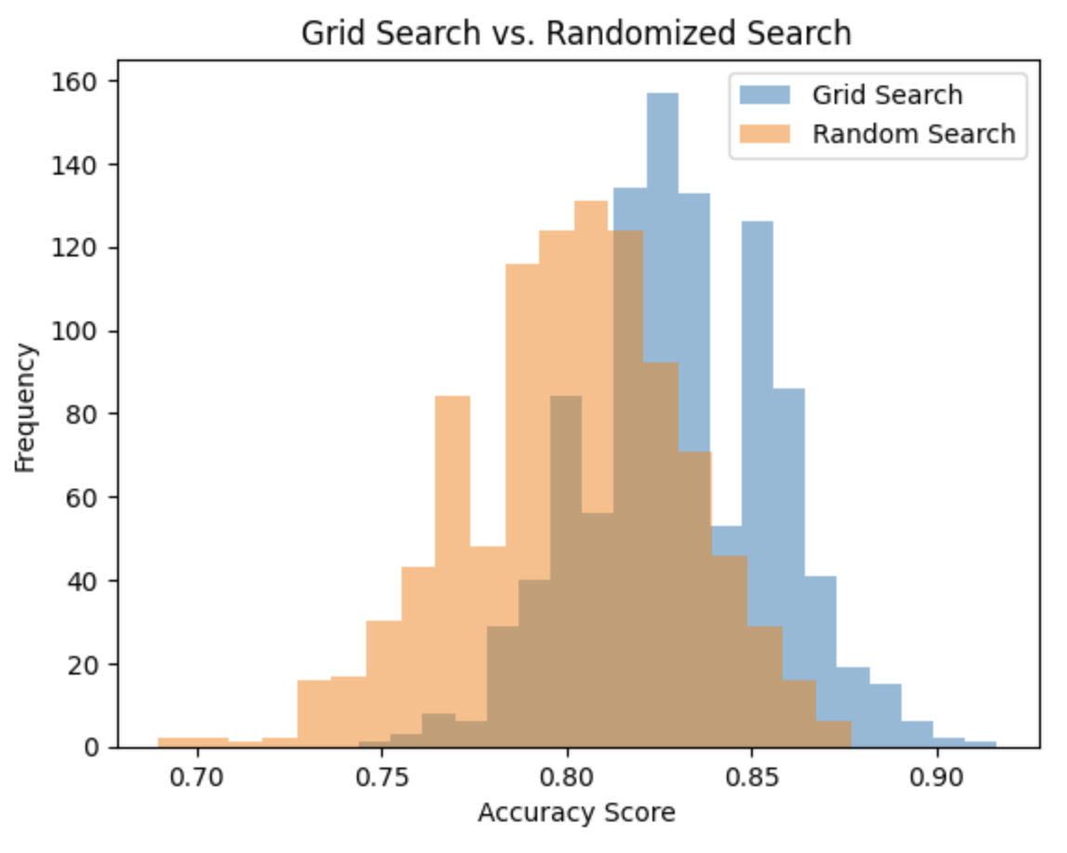
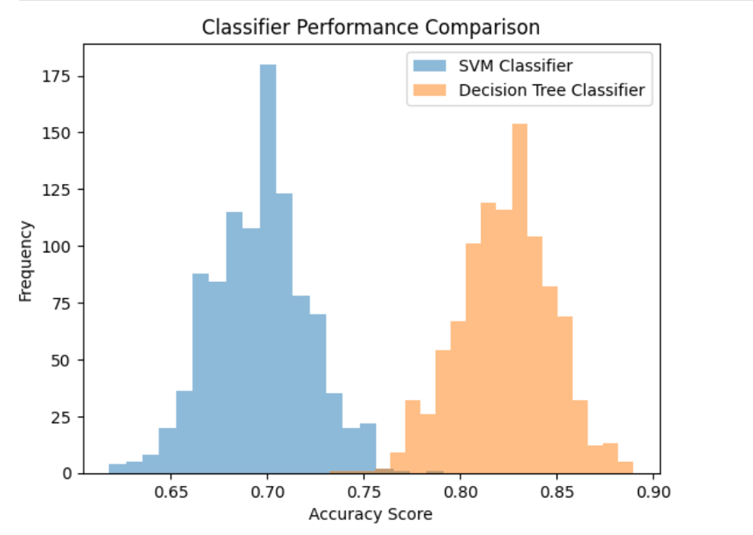
Accuracy of Search Models
Notes:
Sean

Slide 12
Explanation of Decision Tree Optimization
Steps to refine our decision tree classifier:
GridSearchCV
ccp_alpha value optimization + max_feature restriction
max_depth value tuning
Notes:
Sean: GridSearchCV algorithm has predicted the results with 83% accuracy.

Slide 13
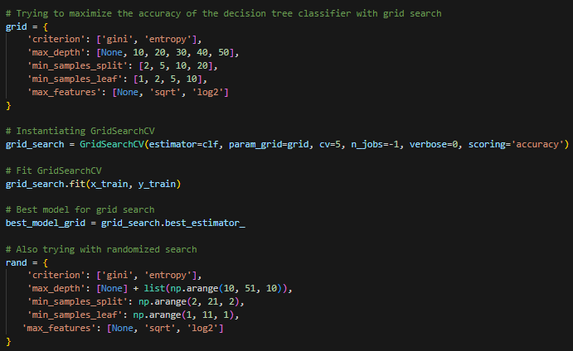
Hyperparameters for grid and randomized search

Slide 14
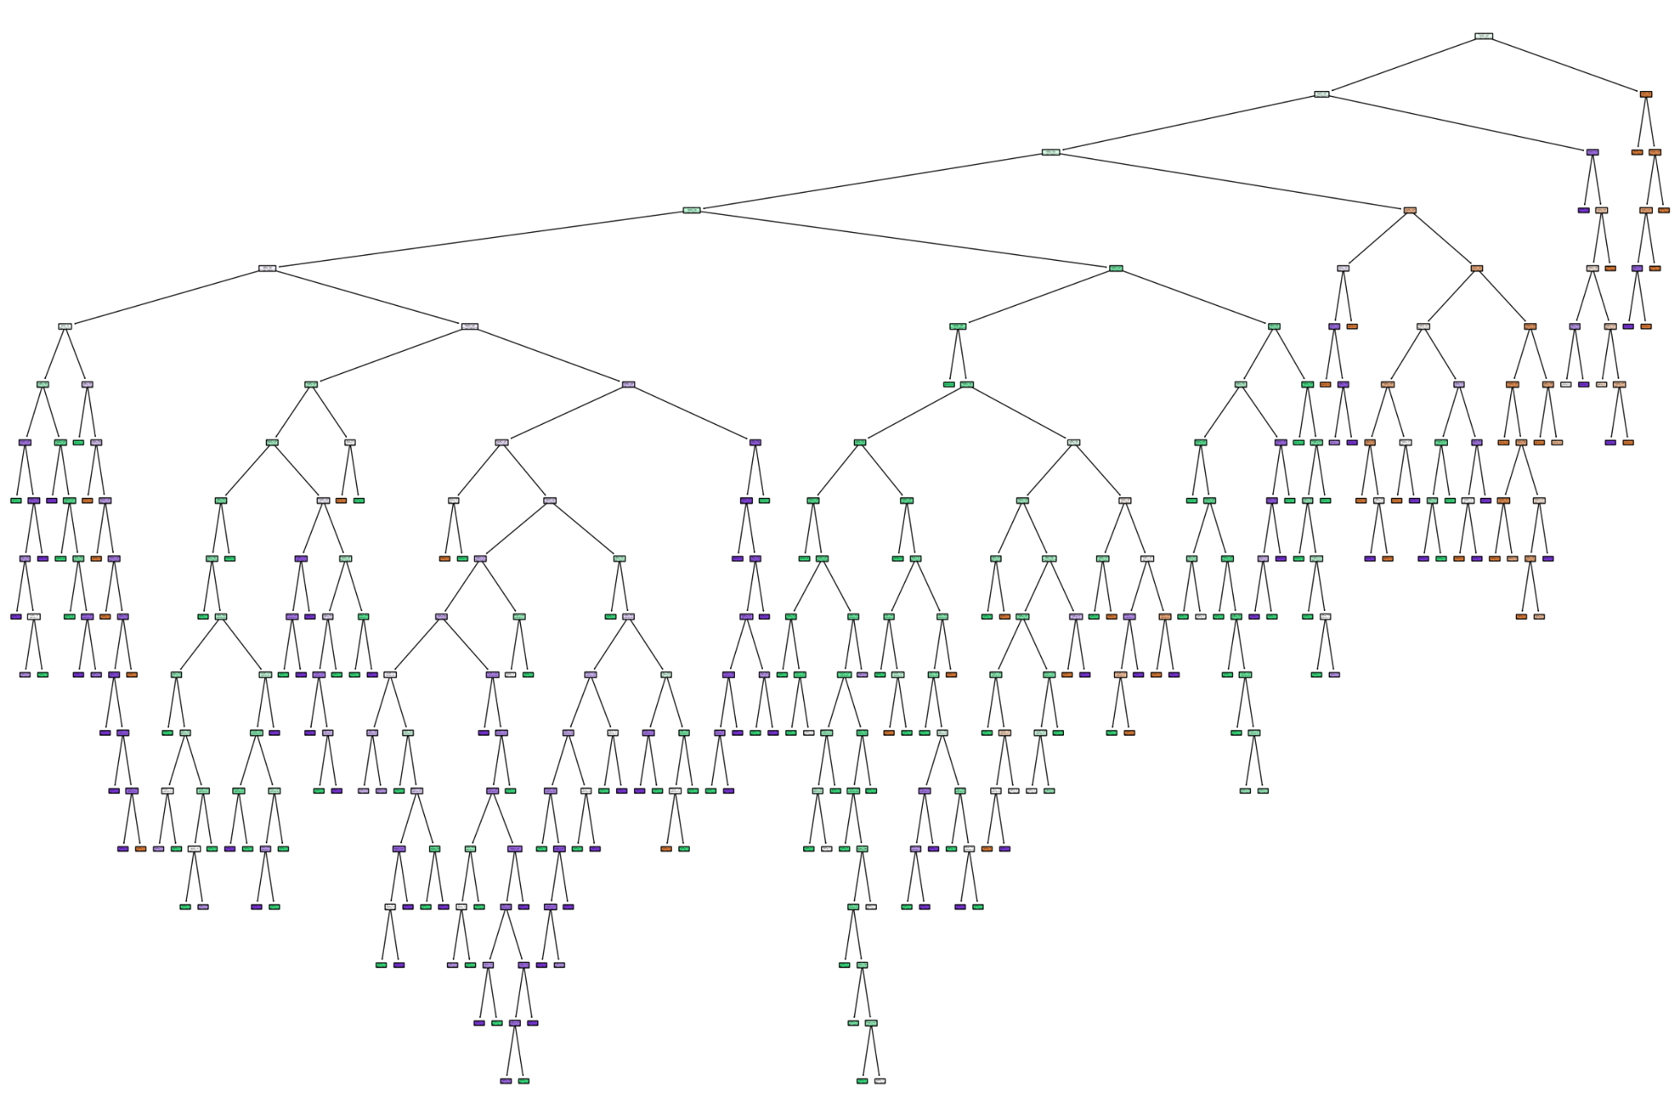
Grid Search Optimized Decision Tree
Accuracy: 83%
Depth: 18

Slide 15
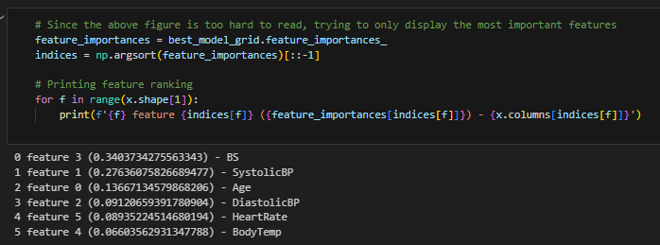
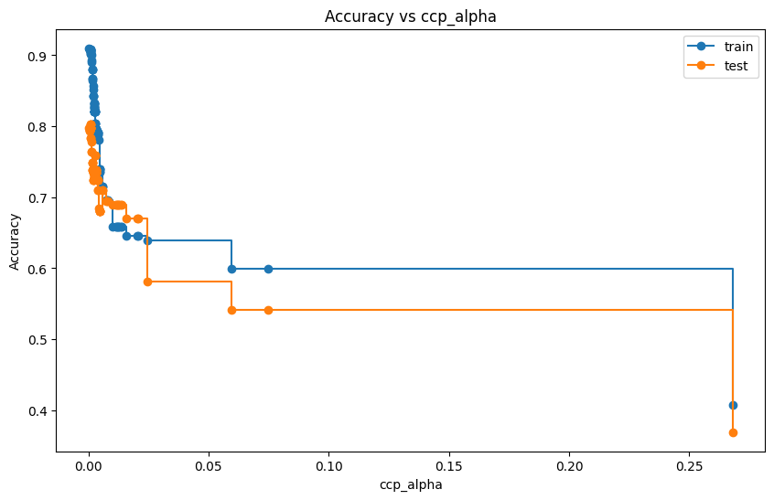
Max_feature restriction and ccp_alpha optimization
Notes:
Sean explanation, if we want to include. Decision tree diagram for GridSearchCV at maximum depth = 4. Include explanation of hyperparameter tuning

Slide 16
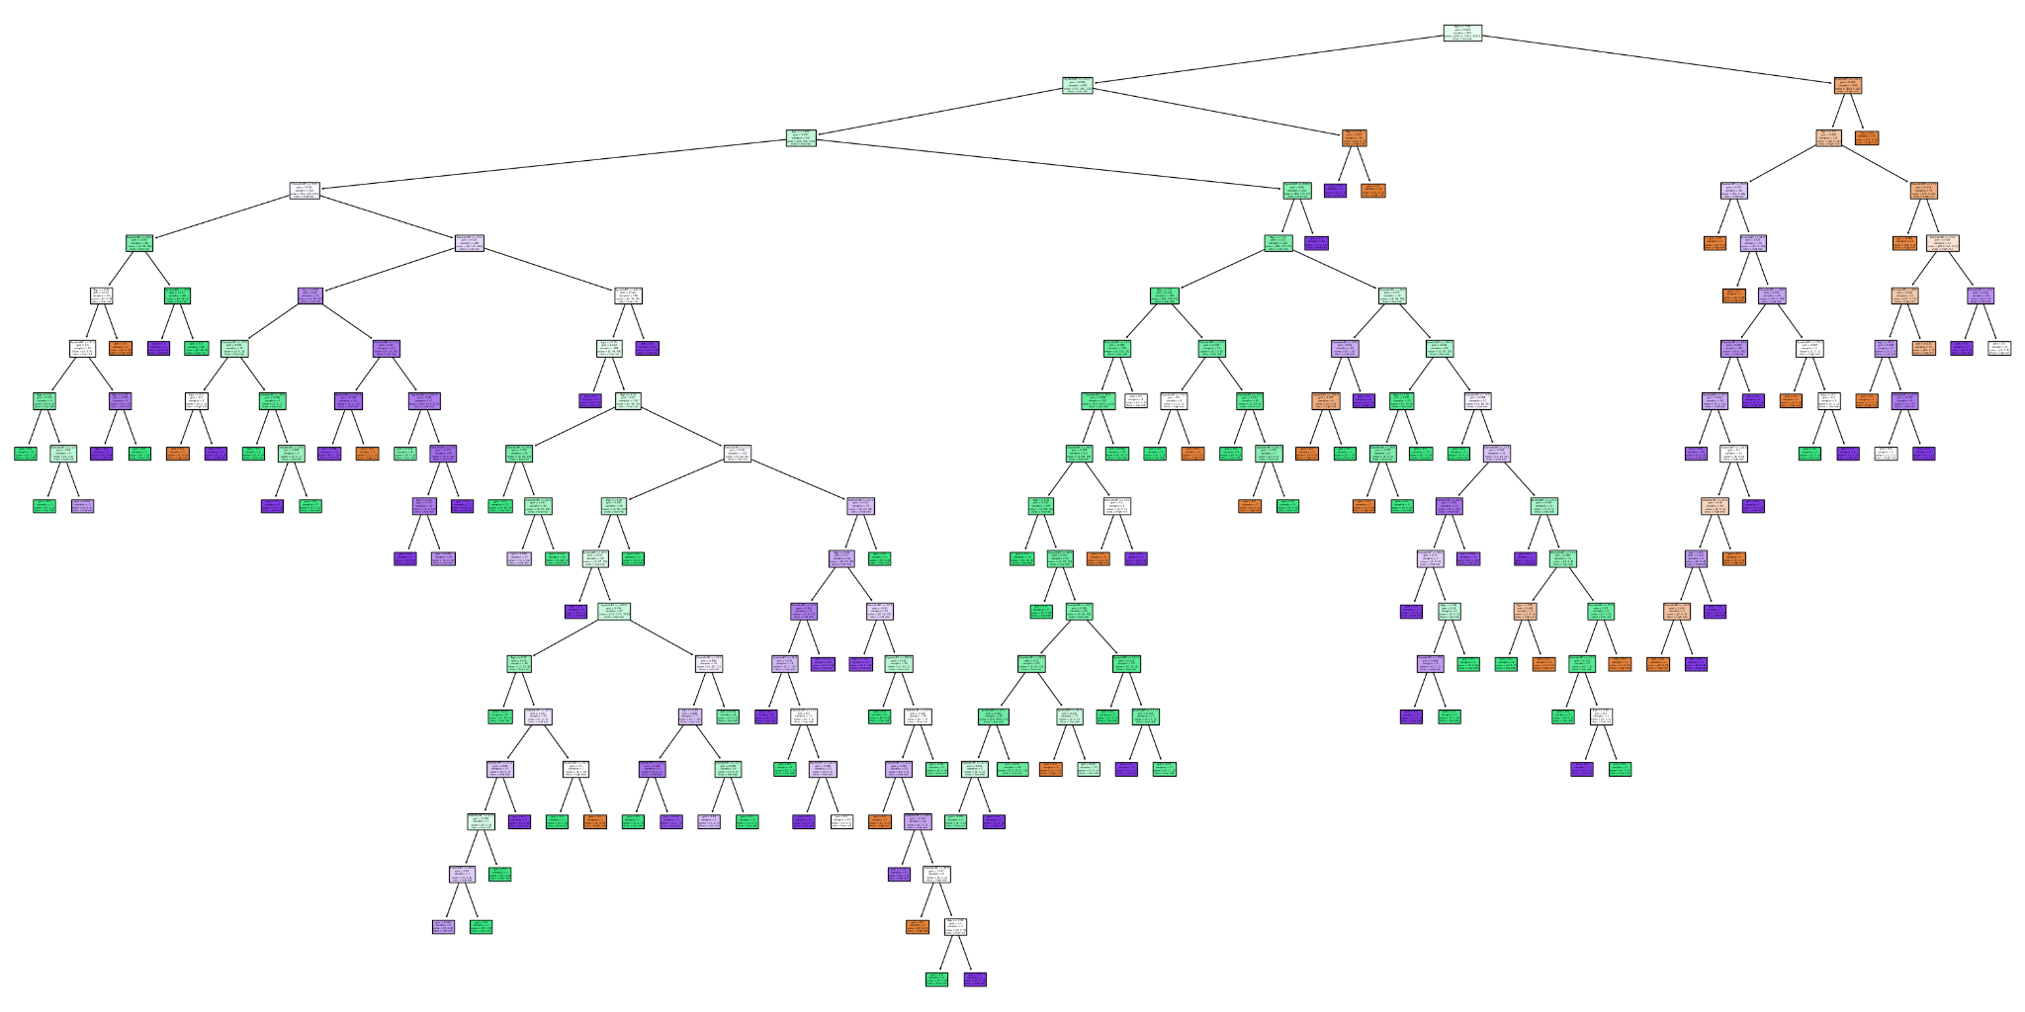
Pruned and Optimized ccp_alpha Tree
Accuracy: 80%
Max_depth: 18

Slide 17
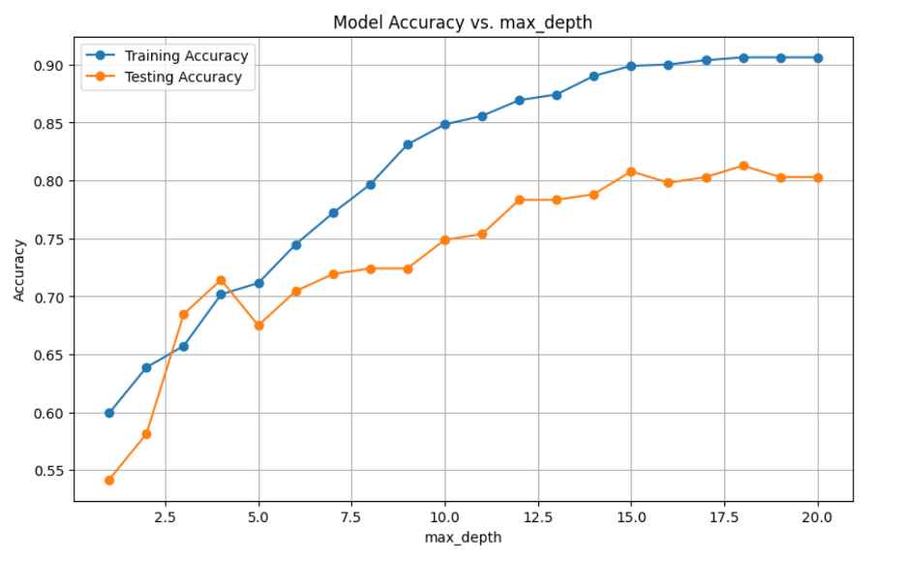
Accuracy of model vs Depth
Notes:
Mani explanation of training

Slide 18
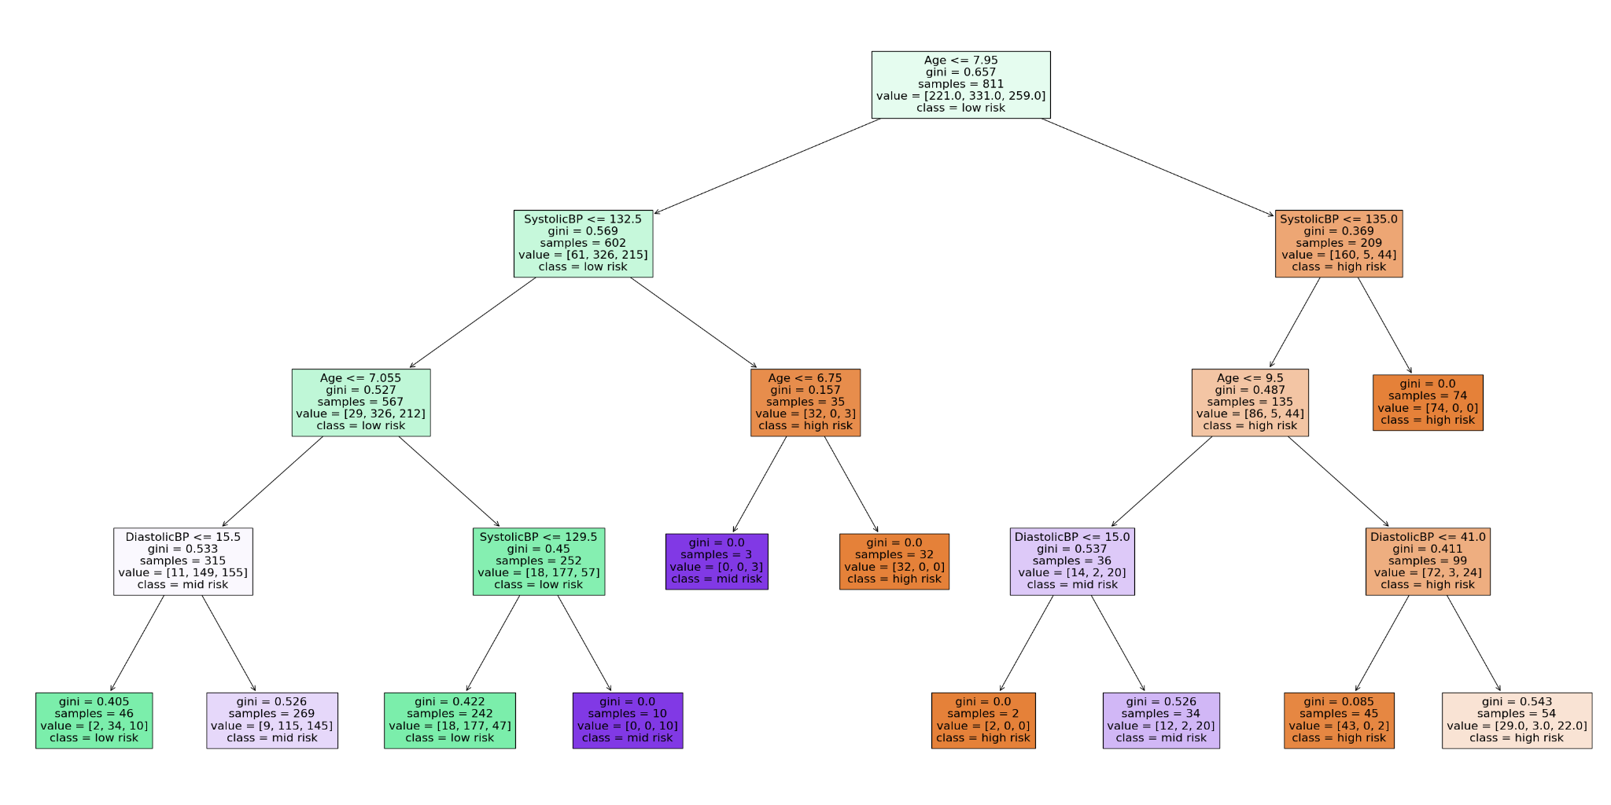
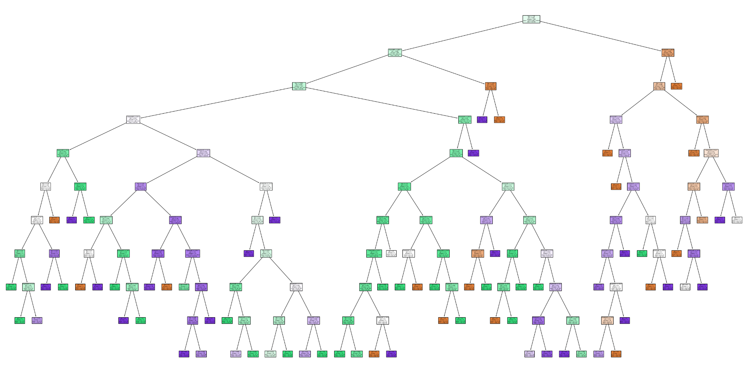
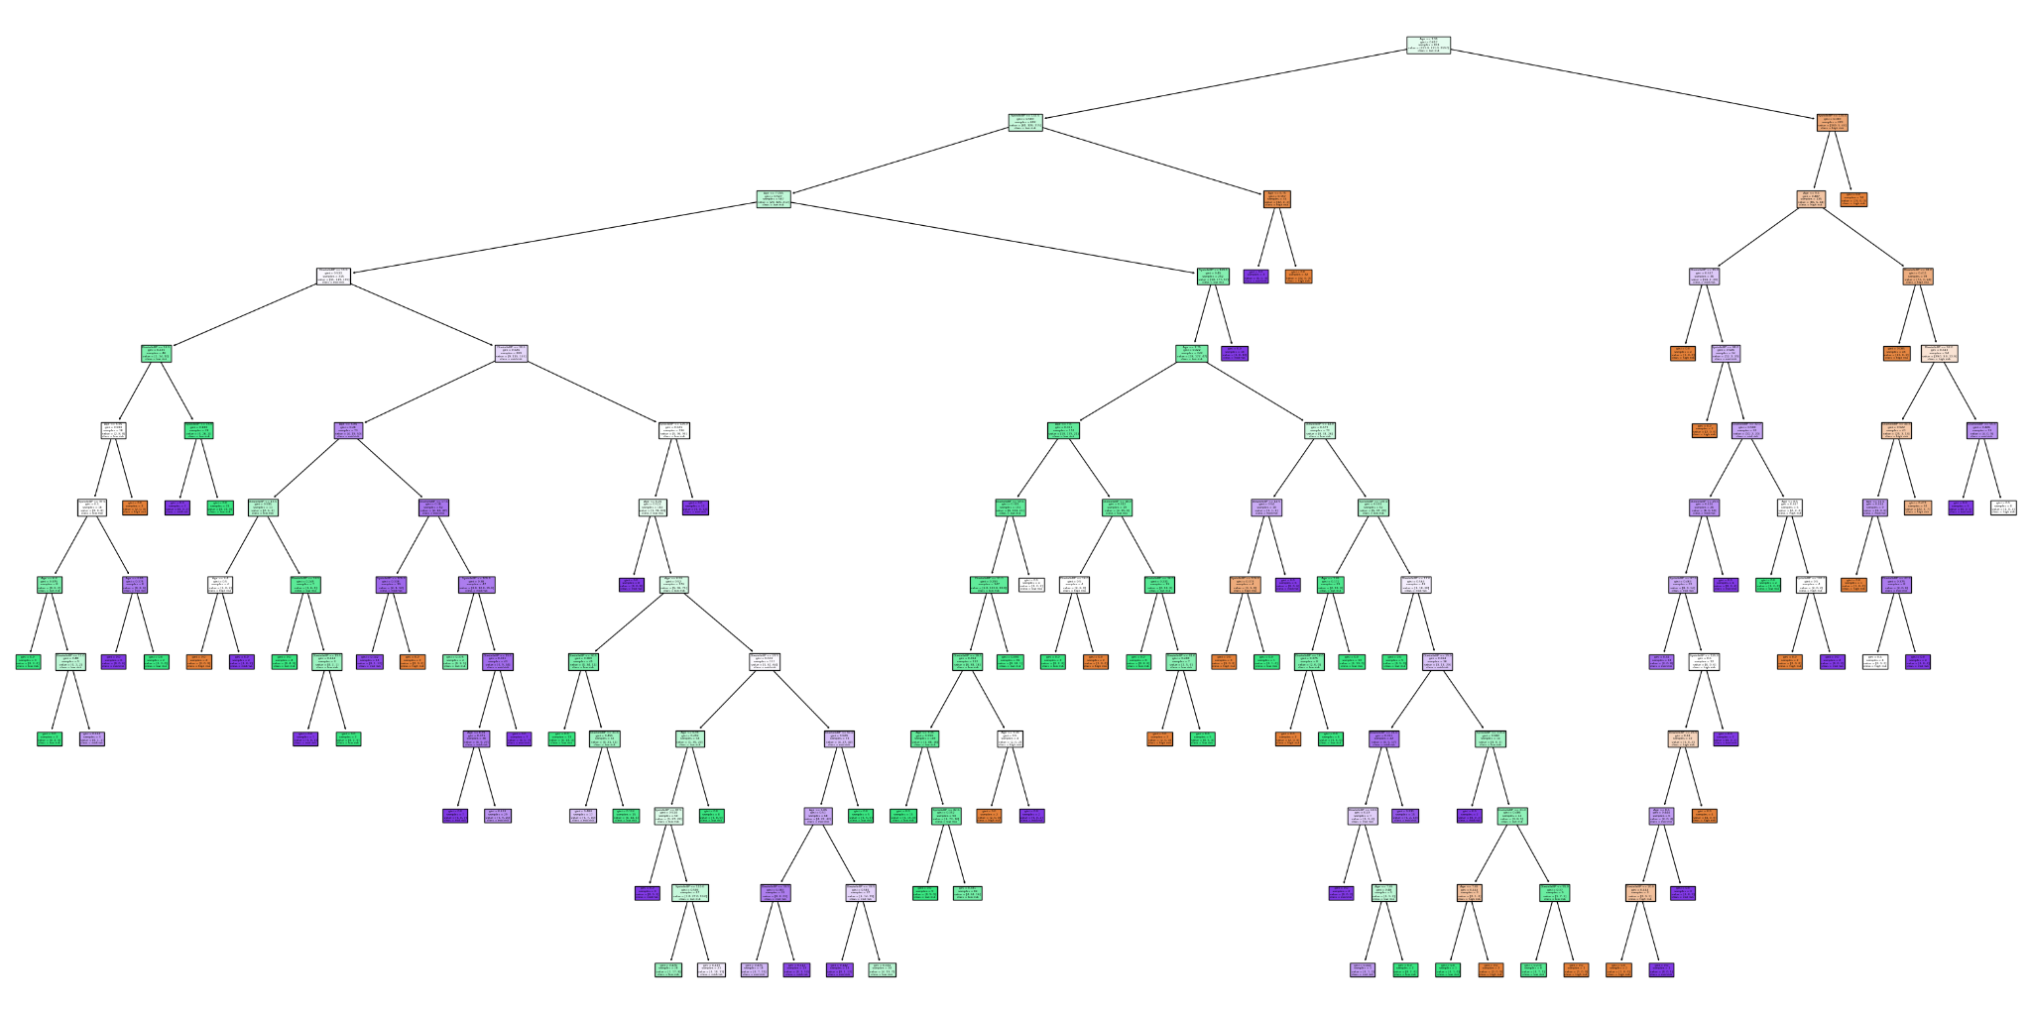
Comparison of different max_depth trees
Accuracy: 71%
Max_depth: 4
Accuracy: 75%
Max_depth: 10
Accuracy: 78%
Max_depth: 12

Slide 19
Alternative Project Ideas?
Places or companies that would find this information useful?
Ways to improve the project?
Notes:
Nabeel?

Slide 20
Conclusion
This research opens the possibility for the use of a decision tree model in predicting maternal health risks and other medical complications, especially in rural areas.
This gives the doctors the ability to triage more patients and, hopefully, save more lives.
We share the ability to offer a viable support tool for significantly improving maternal healthcare in remote areas, with a relatively accurate model.
We may see enhanced health outcomes for newborn children in the same areas due to the implementation of our decision tree.
Notes:
Chris or Nabeel? Triaging more patients, prioritizing high risk patients more quickly

